Slide 1
FINTECH PRODUCT PERFORMANCE
Credit Risk, Customer Behavior & Revenue Analysis
Reporting Period: January 2024 – December 2025
115,539 applications · 144,561 transactions · 100,000 users

Slide 2
Executive Summary
APPLICATIONS
APPROVAL RATE
DEFAULT RATE
FRAUD RATE
115,539
68.4%
5.06%
1.02%
−0.6% YoY
Stable
⚠ Uniform
Well controlled
Key Findings
1. Stable demand: YoY change is <1% across all credit metrics. No alarming decline.
2. Default rate flat at 5% across ALL score bands: Scoring model may lack discriminatory power — most critical finding.
3. Conversion funnel gap: Only 19.5% of app opens convert. Biggest drop: product view → add to cart (43% loss).
4. LTV uniform ($2,501): No difference between free, premium, and enterprise accounts.
Credit Risk, Customer Behavior & Revenue Analysis

Slide 3
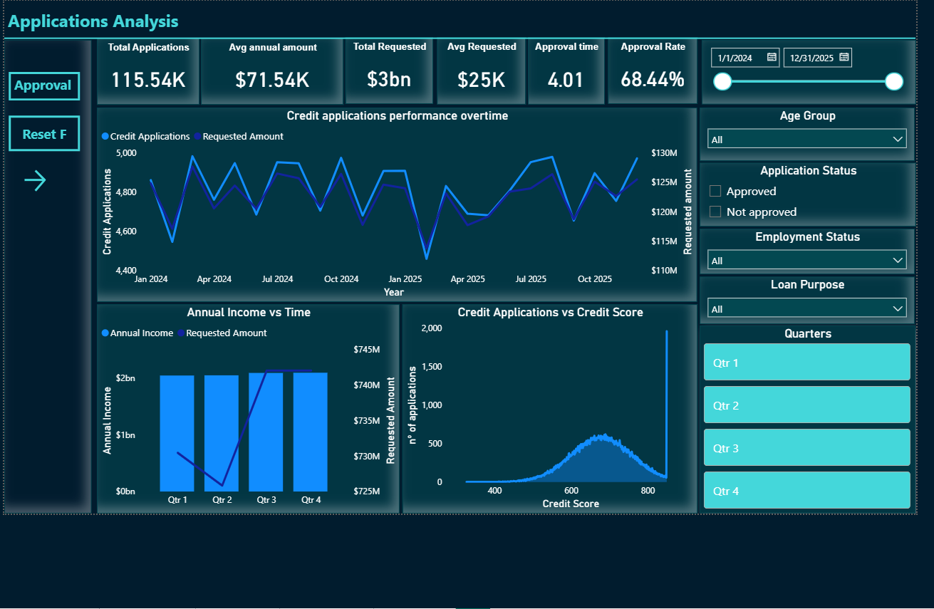
1
Credit Demand: Stable
Metric | 2024 | 2025 | Change
Applications | 57,950 | 57,589 | −0.62%
Total Requested | $1.477B | $1.464B | −0.90%
Approval Rate | 68.49% | 68.40% | −0.09 pp
Avg Income | $71,791 | $71,282 | −0.71%
SEASONAL PATTERN
Q1 dips 2–3% each year (Feb weakest). Q3–Q4 marginally stronger. All changes within noise range.
Actions
Run Q4 acquisition campaigns to capitalise on stronger demand and build Q1 pipeline
A/B test loan conditions (rates, terms) during Q1 for personal/home loans
Investigate competitor Q1 promotions drawing applicants away
Credit Risk, Customer Behavior & Revenue Analysis
3

Slide 4
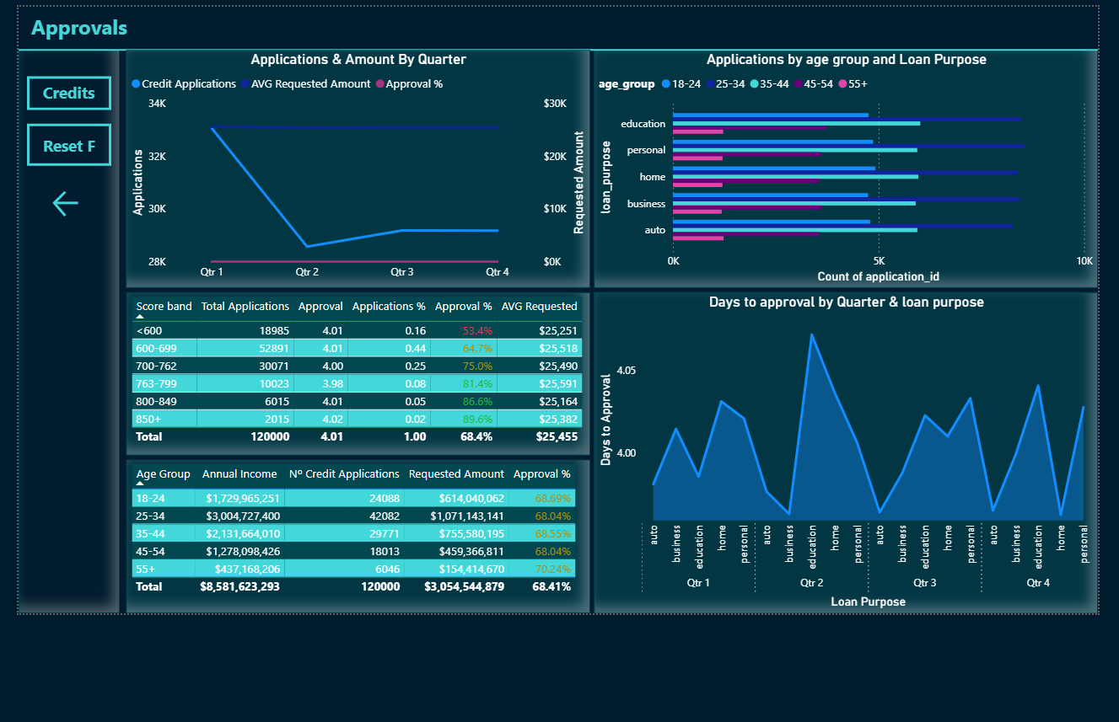
2
Credit Risk: Uniform Default Rate
Score Band | Apps | % Total | Approval % | Default %
<600 | 18,260 | 15.8% | 53.5% | 5.01%
600–699 | 50,918 | 44.1% | 64.7% | 5.04%
700–762 | 28,944 | 25.1% | 75.1% | 5.14%
763–799 | 9,654 | 8.4% | 81.4% | 5.06%
800–849 | 5,800 | 5.0% | 86.5% | 4.93%
850+ | 1,963 | 1.7% | 89.7% | 5.28%
⚠ CRITICAL FINDING
Default rate is ~5% across ALL score bands. The scoring model does not differentiate risk. We're rejecting 47% of <600 applicants for no material risk reduction.
Actions
Implement risk-based pricing by band
Analyse default timing (early vs late)
Credit Risk, Customer Behavior & Revenue Analysis
4

Slide 5
3
Customer Segments: Volume Without Differentiation
Age Group
Account Type
Age | Apps | % Total | Avg LTV
18–24 | 23,178 | 20.1% | $2,492
25–34 | 40,513 | 35.1% | $2,499
35–44 | 28,698 | 24.8% | $2,513
45–54 | 17,331 | 15.0% | $2,501
55+ | 5,819 | 5.0% | $2,494
Type | Apps | % Total | Avg LTV
Free | 80,740 | 69.9% | $2,503
Premium | 29,215 | 25.3% | $2,499
Enterprise | 5,584 | 4.8% | $2,492
25 – 34 = VOLUME LEADER
35.1% of apps, highest total income ($2.9B). But avg LTV ($2,499) is identical to other groups. Volume ≠ value.
NO LTV DIFFERENTIATION
Premium & enterprise accounts produce identical LTV to free accounts. Paid tiers are not driving higher value.
Actions
Focus acquisition on 25 – 34 for volume; develop upsell paths to increase ARPU
Redesign premium/enterprise benefits: lower rates, faster approval, higher limits
Review unemployed applicant approval criteria (10.2% of apps, 68.7% approval rate)
Credit Risk, Customer Behavior & Revenue Analysis
5

Slide 6
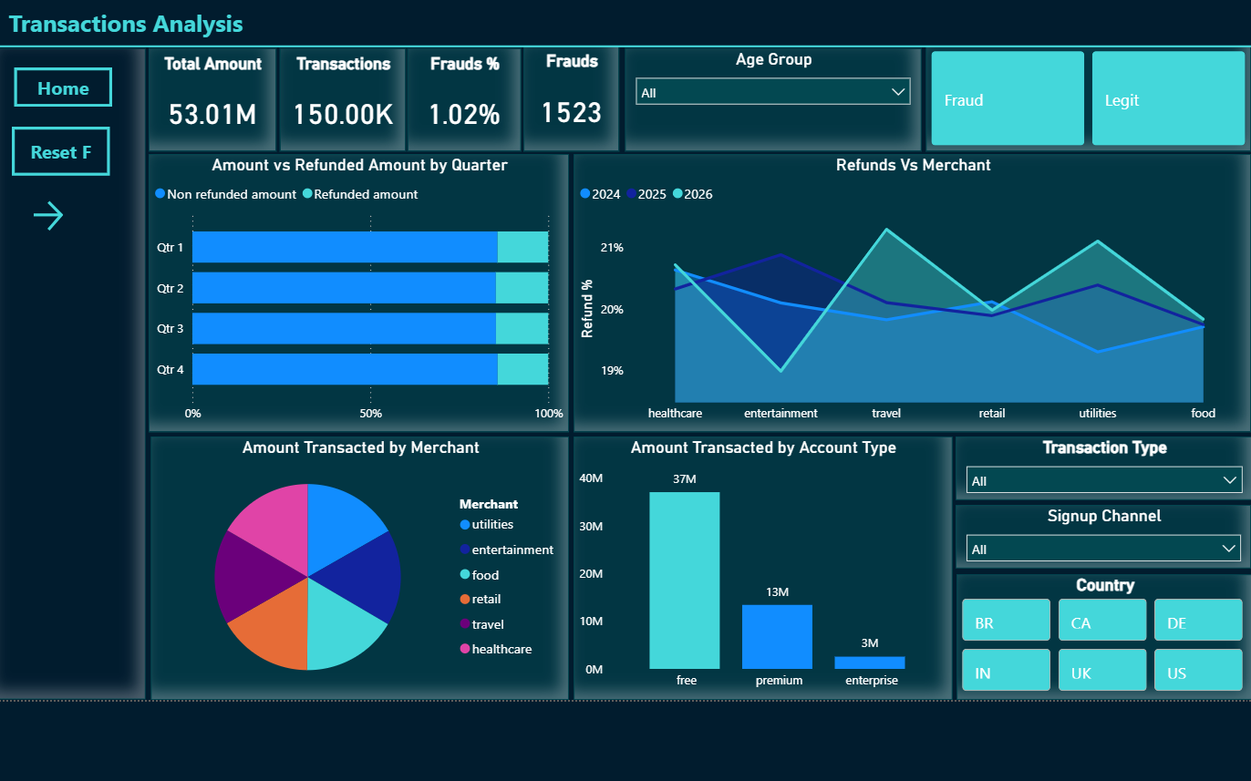
4
Transactions: Controlled Risk
TRANSACTIONS
VOLUME
FRAUD RATE
US SHARE
144,561
$51.0M
1.02%
40.2%
⚠ DATA CLARIFICATION: "REFUNDS"
The "20% refund rate" = proportion of refund-type transactions (1 of 5 types, each ~20%). Zero records have status='refunded'. This is not a customer satisfaction issue — it's a data labelling confusion. Relabel on dashboard.
Top Markets
Country | Txns | Amount | Fraud %
US | 58,149 | $20.6M | 1.02%
UK | 21,530 | $7.5M | 1.10%
BR | 21,729 | $7.7M | 0.97%
DE | 14,560 | $5.2M | 0.97%
Credit Risk, Customer Behavior & Revenue Analysis
6

Slide 7
5
Conversion Funnel: Where Users Drop Off
App Open
100%
128K
View Homepage
84.4%
108K
View Product
70.3%
90K
−43%
BIGGEST
DROP
Add to Cart
39.8%
51K
Begin Checkout
29.7%
38K
Add Payment
25%
32K
Submit Order
21.9%
28K
Confirmed
19.5%
25K
BOTTLENECK: View Product → Add to Cart loses 43% of users. This single step is the #1 UX optimisation target.
MOBILE FIRST: 80% of sessions on iOS/Android.
Credit Risk, Customer Behavior & Revenue Analysis
7

Slide 8
Strategic Recommendations
Ranked by expected business impact
1
Audit Credit Scoring Model
HIGH
Uniform 5% default rate means we reject 47% of <600 applicants for no risk reduction. Fix this to unlock revenue.
2
Fix Conversion Funnel
HIGH
19.5% conversion rate. Product→Cart loses 43%. A 10pp improvement here 20% more confirmed orders.
3
Differentiate Account Tiers
MEDIUM
LTV is identical ($2,501) across free/premium/enterprise. Redesign paid benefits to drive real value.
4
Seasonal Marketing Calendar
MEDIUM
Q4 campaigns for natural demand; Q1 retention offers for seasonal dip. Target 25 – 34, personal/home loans.
Credit Risk, Customer Behavior & Revenue Analysis
8

Slide 9
Thank You
Duarte Cardoso | Data Analyst
Full report and data available in the GitHub repository
Credit-Risk-Customer-Behavior-Revenue-Analysis-Fintech

